Slide 1
WEDNESDAY 11.30
MDM COLLABORATION MEETING
NEXT WEEK: LEVETTE

Slide 2
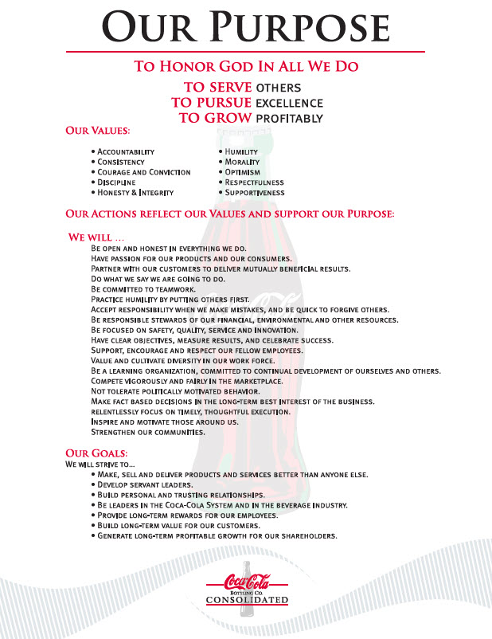
Notes:
Voice: Thank you for your time in completing this module. You are embodying many of our actions that support Our Purpose and helping Consolidated reach Our Goals.

Slide 3
Pulse
    I feel like I really belong at Coca-Cola Consolidated (Company)
When I do an excellent job, my accomplishments are recognized (Jeff)
I can achieve my career goals at Coke Consolidated (MDM)

Slide 4
Agenda
LEAH’S BIRTHDAY LIST
CHRISTMAS DECORATION
CHRISTMAS BREAKFAST 12.14
TREE LIGHTING
ANGEL TREE
P & R ANNOUNCEMENTS
MY CAREER/END OF YEAR
POP QUIZ

Slide 5
Leah

Slide 6
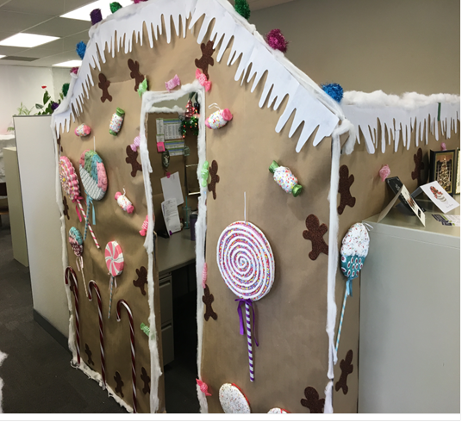
CHRISTMAS DECORATION CONTEST
Team,
We will continue the tradition of decorating our spaces for Christmas for those who would like to participate. Can’t wait to see your creativity and how festive our room will look!
All decorating must be completed before 10:00 am 12/14.
Team voting will take place during our Christmas breakfast and the winner announced after breakfast.
Good luck!

Slide 7
Christmas Breakfast and Tree Lighting

Slide 8
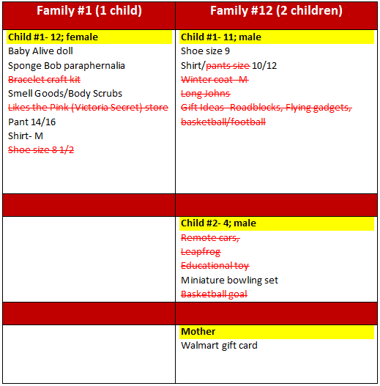


Slide 9
P&R ANNOUNCEMENTS

Slide 10
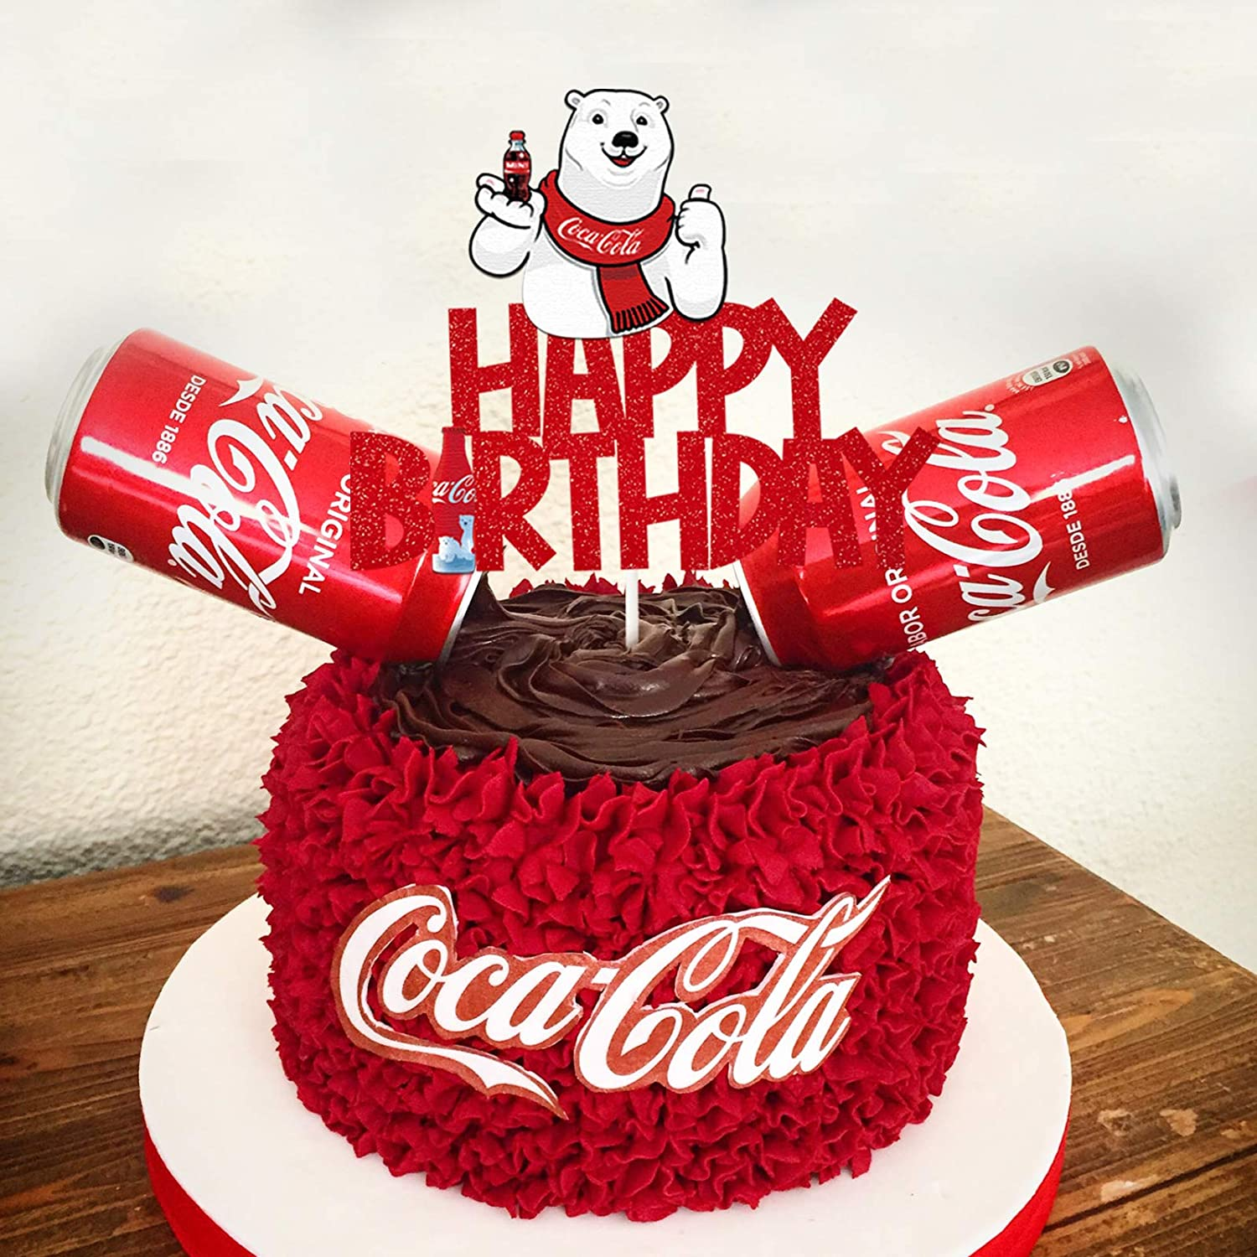
HAPPY BIRTHDAY!
Sheryl 12/13
Levette 12/18
Jesus 12/25 ☺

Slide 11

HAPPY ANNIVERSARY!
None

Slide 12
CONGRATULATIONS!
Brandon Llorens
Selected by his peers
in the MDM Department
to be Teammate of the Month for
December 2022

Slide 13
Way to go, Brandon!
“Brandon is always willing to do what is asked of him.”
“Brandon is eager to learn and take on more responsibilities.”
“Brandon is a team player and always encourages his teammates.”

Slide 14
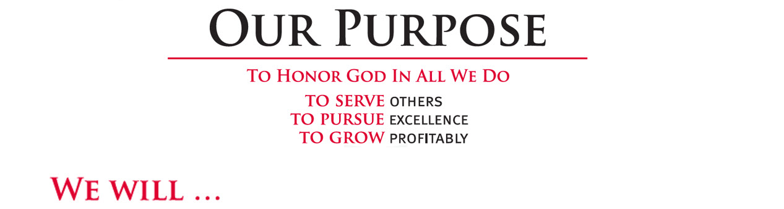
Brandon exemplifies OUR PURPOSE!
IS OPEN AND HONEST IN EVERYTHING THEY DO.
PARTNERS WITH OUR CUSTOMERS TO DELIVER MUTUALLY BENEFICIAL RESULTS.
SUPPORT, ENCOURAGE AND RESPECT OUR FELLOW EMPLOYEES.
PRACTICES HUMILITY BY PUTTING OTHERS FIRST.
IS COMMITTED TO CONTINUAL DEVELOPMENT.
HAS PASSION FOR OUR PRODUCTS AND OUR CONSUMERS.
Notes:
Voice: Thank you for your time in completing this module. You are embodying many of our actions that support Our Purpose and helping Consolidated reach Our Goals.

Slide 15
MY CAREER/END OF YEAR REVIEW

Slide 16
QUIZ TIME

Slide 17
WHAT DO YOU GET WHEN YOU CROSS A MALE ZEBRA AND A FEMALE HORSE?
HORZE
ZORSE
HORBRA
ZONKEY

Slide 18
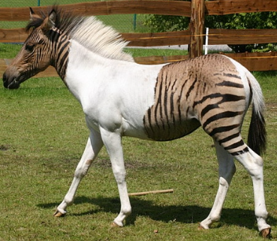
WHAT DO YOU GET WHEN YOU CROSS A MALE ZEBRA AND A FEMALE HORSE?
HORZE
ZORSE
HORBRA
ZONKEY
A male zebra and a female horse is called a ‘Zorse.

Slide 19
THE FEAR OF GARLIC IS CALLED:
ALLIUMPHOBIA
VAMPIROPHOBIA
SATIPHOBIA
CLOVYEPHOBIA

Slide 20
THE FEAR OF GARLIC IS CALLED
ALLIUMPHOBIA
VAMPIROPHOBIA
SATIPHOBIA
CLOVYEPHOBIA
Alliumphobia. The Scientific name of garlic is Allium Sativum.

Slide 21
HUBERT WOLFE IS KNOWN FOR HAVING HOW MANY FIRST NAMES?
16
7
11
26

Slide 22
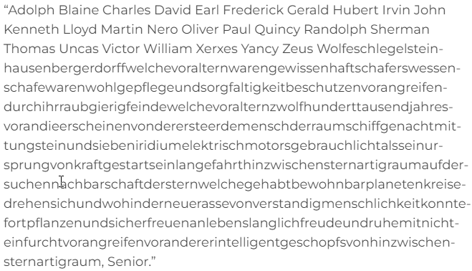
HUBERT WOLFE IS KNOWN FOR HAVING HOW MANY FIRST NAMES?
16
7
11
26
26! You should totally check out this article on Reader’s Digest : https://www.rd.com/article/26-first-names-longest-last-name-world/

Slide 23
WHAT IS THE MOST COMMONLY USED LETTER IN THE ENGLISH LANGUAGE?
E
A
R
I

Slide 24
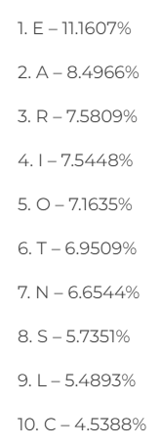
WHAT IS THE MOST COMMONLY USED LETTER IN THE ENGLISH LANGUAGE?
E
A
R
I

Slide 25
WHAT DO YOU GET WHEN YOU CROSS A FEMALE ZEBRA AND A MALE HORSE?
HORZE
ZORSE
HORBRA
ZONKEY

Slide 26
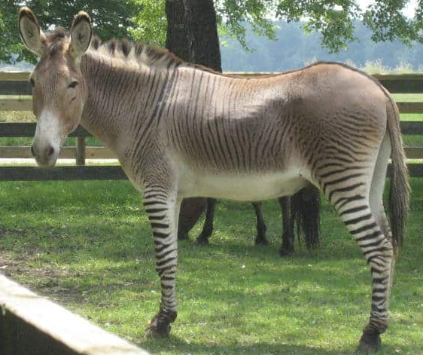
WHAT DO YOU GET WHEN YOU CROSS A FEMALE ZEBRA AND A MALE HORSE?
HORZE
ZORSE
HORBRA
ZONKEY
A female zebra and a male horse is called a ‘Zonkey'

Slide 27
WHAT STATE HAS THE NICKNAME “THE OCEAN STATE”?
RHODE ISLAND
HAWAII
ALASKA
CALIFORNIA

Slide 28

WHAT STATE HAS THE NICKNAME “THE OCEAN STATE”?
RHODE ISLAND
HAWAII
ALASKA
CALIFORNIA
The smallest state in America does boast some beautiful beaches. Despite that, though, the “Ocean State” nickname might be better suited to the U.S. state with the longest coastline—Alaska. Alaska’s coastline, in fact, is longer than those of all 49 other states combined.

Slide 29
WHAT WORD IS THE MOST COMPLICATED WORD IN THE ENGLISH LANGUAGE?
LOG
RUN
CAN
SET

Slide 30
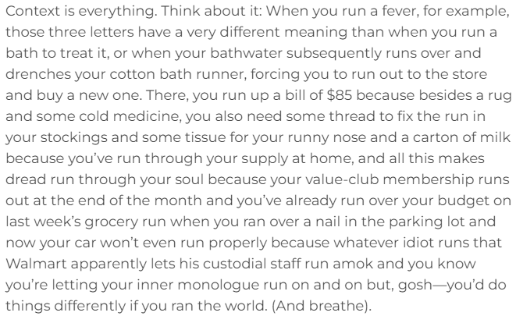
WHAT WORD IS THE MOST COMPLICATED WORD IN THE ENGLISH LANGUAGE?
LOG
RUN
CAN
SET
Run… there are no fewer than 645 different usages for the verb form alone!

Slide 31
Any additional comments or questions?

Slide 32
THE END

